Slide 1
Transcription of Percussion Instruments in Polyphonic Audio
Mid Term Results
Beach Clark, Daniel Ethridge, and Laney Light
10/21/2019

Slide 2
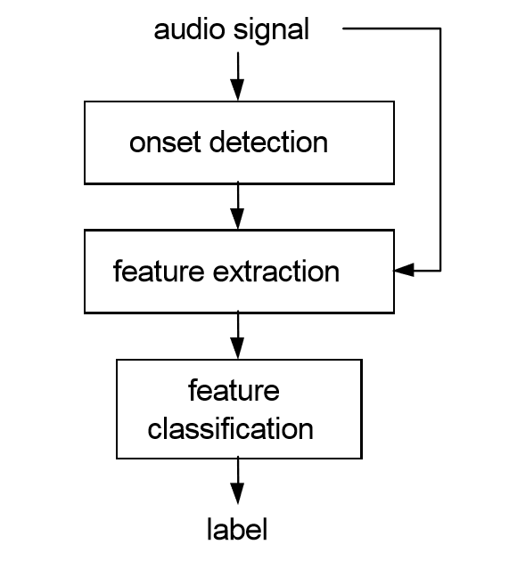
Data Source
Problem Statement
Transcribe specific percussive sounds in a polyphonic texture
General Approach
MedleyDB drums*
Annotated with instruments at specific times
*Southall, Carl, Chih-Wei Wu, Alexander Lerch, and Jason Hockman. “MDB DRUMS: AN ANNOTATED SUBSET OF MEDLEYDB FOR AUTOMATIC DRUM TRANSCRIPTION,” n.d., 2.

Slide 3
Descriptive Statistics
23 tracks
7994 annotated percussion onsets
6 percussion instruments
Instrument | Number of Onsets
Snare Drum (SD) | 2654
Hi-Hat (HH) | 2639
Kick Drum (KD) | 1539
Cymbal (CY) | 1002
Tom (TT) | 90
Other (OT) | 70
Number of Instruments in Same Window | Percent of Total Onsets
1 | 75.6%
2 | 24.1%
3 | 0.3%
Notes:
Other=side stick or tambourine

Slide 4
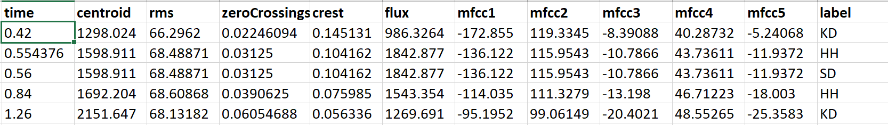
Onset Detection
Madmom: Python audio signal processing library
Recurrent neural network (RNN) onset processor
User-defined window (milliseconds)
Features
Calculated 10 features for every window
Normalized each feature over all files
Mapped features to annotated labels by time window
Notes:
If time allows: rows 2 and 3 are an example of 2 instruments at almost the same time (same window, features are the same)

Slide 5
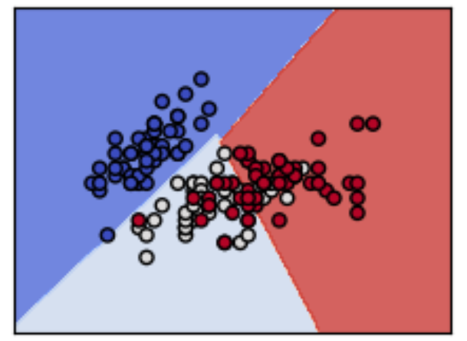
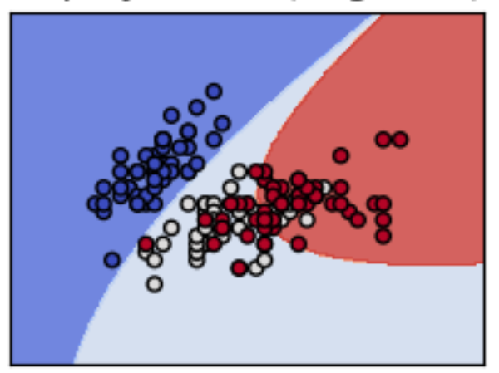
Classification Model
Separated data into testing (25%) and training (75%)
Support Vector Machine (SVM)
Implemented using scikit-learn
Can handle multi-class categorization, with multiple instruments in same window
Kernel options include linear and polynomial
Notes:
Plots are from scikit-learn documentation. The kernel specifies the shape of the function used to create the decision boundaries.

Slide 6
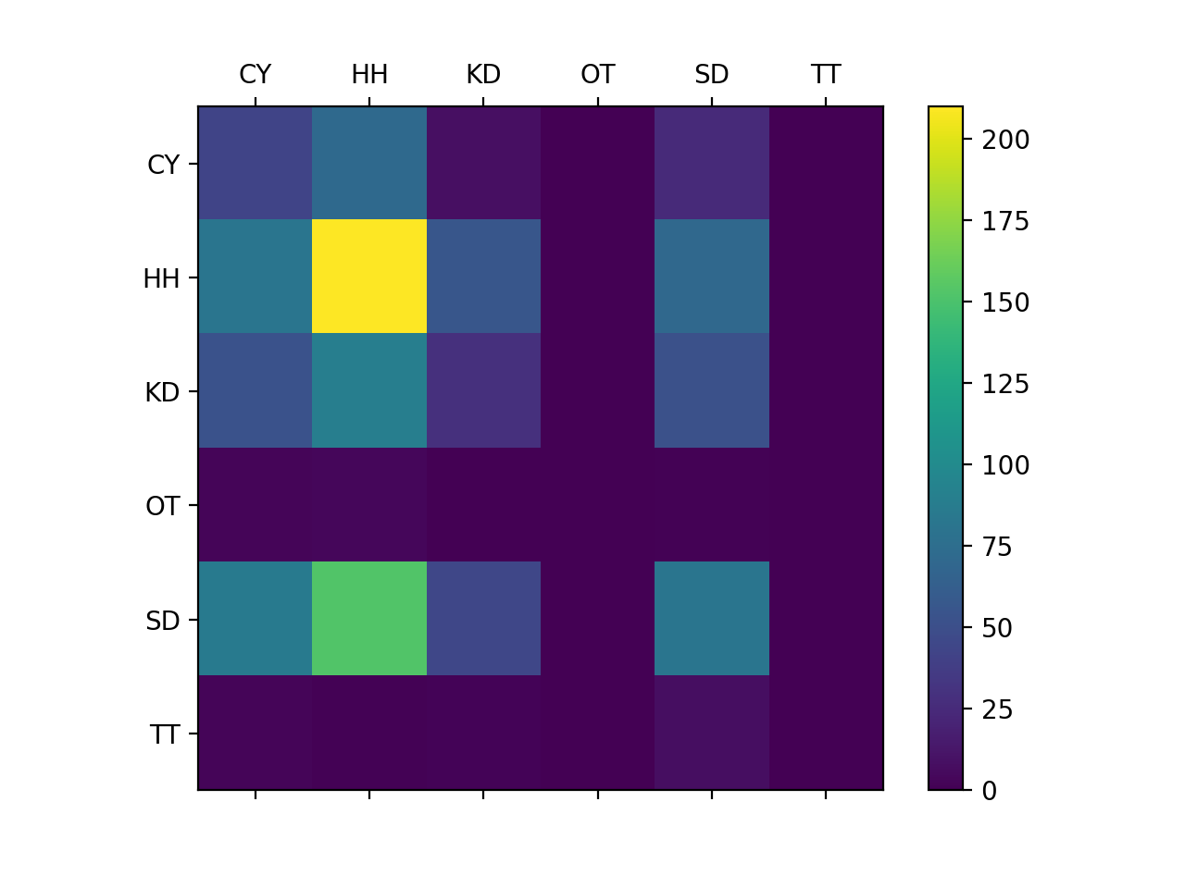
Results
Confusion
Matrix
Instrument | Precision | Recall | F1-score | N observations
HH | 0.40 | 0.50 | 0.44 | 419
SD | 0.34 | 0.22 | 0.27 | 366
KD | 0.21 | 0.13 | 0.16 | 224
CY | 0.16 | 0.29 | 0.21 | 149
TT | 0.00 | 0.00 | 0.00 | 14
OT | 0.00 | 0.00 | 0.00 | 8
Accuracy |  |  | 0.31 | 1180
Macro Avg | 0.18 | 0.19 | 0.18 | 1180
Weighted Avg | 0.31 | 0.31 | 0.30 | 1180
Notes:
If the model was doing a good job, we would see yellow and green on the diagonal
F score is our main evaluation metric. It is doing a decent job of predicting the hi hat but the F-score is lower for the less prevalent instruments.

Slide 7
Challenges and Next Steps
Data set is small
Use N-fold cross validation
Supplement with additional data sources
Model rarely predicts the 2 least common instruments
Consider removing them from the model
SVM is not working well for kick drum
Apply low pass filter
All features may not be important in the model
Distribution plots of features
Use logistic regression to see which features are important for each instrument
Narrow down with backward selection
Different classification algorithms
K-nearest neighbors

